Slide 1

STAT 426 Project 2
Low Birthweight Analysis
Shuyu Jia (shuyuj2)

Slide 2
1. Introduction
Low birthweight is when a baby is born weighing less than 5 pounds, 8 ounces (2.5 kg)
Being low birthweight can cause health problems for some babies
About 1 in 12 babies (about 8%) in the US is born with low birthweight
Two main reasons for low birthweight:
  Premature birth
  Fatal growth restriction (FGR)
Main goal for this project
  Find out factors that are associated with low infant birthweight
  Predict low birthweight

Slide 3
2. Data
The dataset includes birthweights and 9 other variables for 189 births
Continuous variables:
  mother's age in years (age)
  mother's weight in pounds (lwt)
  birth weight in grams (bwt)
Categorical variables:
  indicator of birth weights less than 2.5 kg (low) --- binary
  smoking status during pregnancy (smoke) --- binary
  history of hypertension (ht) --- binary
  presence of uterine irritability (ui) --- binary
  number of previous premature labours (ptl) --- ordinal
  number of physician visits during the first trimester (ftv) --- ordinal
  mother's race (race) --- nominal

Slide 4
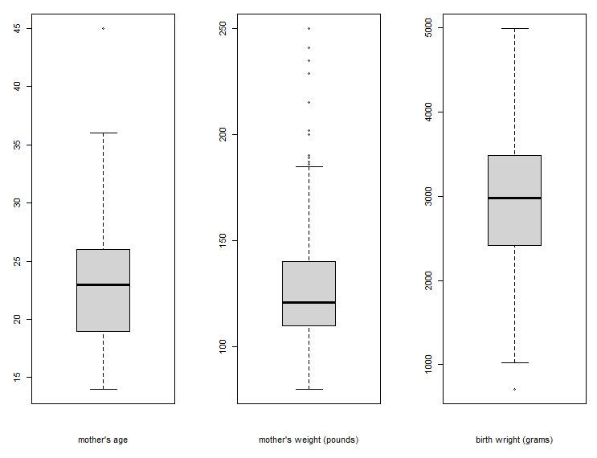
Continuous variables
 | Mother’s age (year) | Mother’s weight (pounds) | Birth weight (grams)
Min | 14 | 80 | 709
1st Quartile | 19 | 110 | 2414
Median | 23 | 121 | 2977
Mean | 23.24 | 129.8 | 2945
3rd Quartile | 26 | 140 | 3487
Max | 45 | 250 | 4990

Slide 5
Binary variables
indicator of birth weights less than 2.5 kg
smoking status during pregnancy
low | 0 | 1
Observation | 130 | 59
Proportion | 68.8% | 31.2%
smoke | 0 | 1
Observation | 115 | 74
Proportion | 60.8% | 39.2%
history of hypertension
presence of uterine irritability
ht | 0 | 1
Observation | 177 | 12
Proportion | 93.7% | 6.3%
ui | 0 | 1
Observation | 161 | 28
Proportion | 85.2% | 14.8%

Slide 6
Ordinal variables
number of previous premature labours
ptl | 0 | 1 | 2 | 3
Observation | 159 | 24 | 5 | 1
Proportion | 84.1% | 12.7% | 2.6% | 0.5%
number of physician visits during the first trimester
ftv | 0 | 1 | 2 | 3 | 4 | 6
Observation | 100 | 47 | 30 | 7 | 4 | 1
Proportion | 52.9% | 24.9% | 15.9% | 3.7% | 2.1% | 0.5%

Slide 7
Nominal variable
mother's race (1 = white, 2 = black, 3 = other)
race | 1 (white) | 2 (black) | 3 (other)
Observation | 96 | 26 | 67
Proportion | 50.8% | 13.8% | 35.4%
Note: Need to change the variable type to factor, otherwise R would treat this variable as numerical.

Slide 8
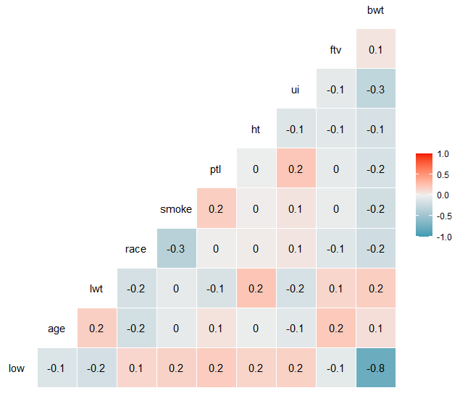
Correlations
`low` is generated from `bwt`, so they are strongly correlated.
No other pair of variables has any strong correlation.

Slide 9
3. Question One (Method & Result)
What factors are associated with low infant birthweight (less than 2.5 kg)?

Slide 10
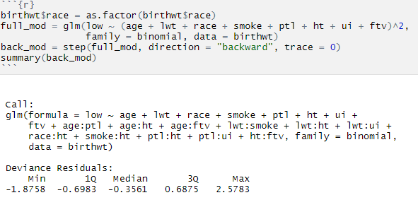
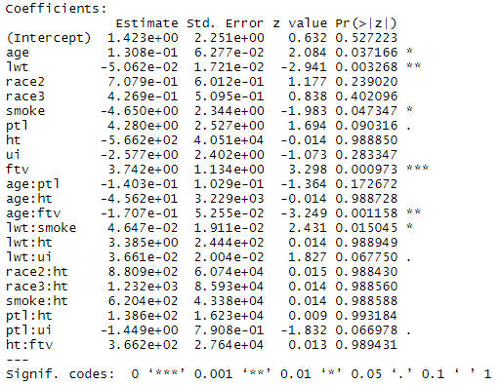
Interaction terms with reasonably low p-values
  age:ptl (0.173)
  age:ftv (0.001)
  lwt:smoke (0.015)
  lwt:ui (0.068)
  ptl:ui (0.067)

Slide 11
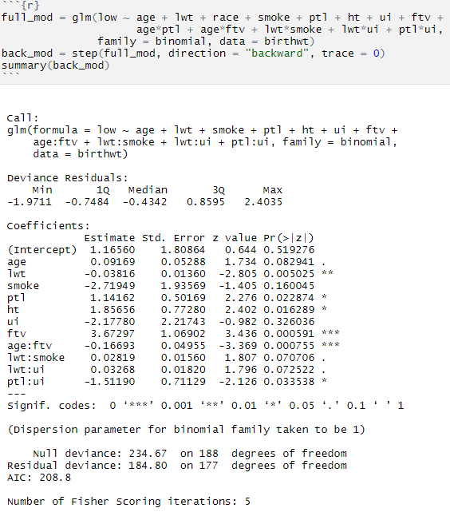
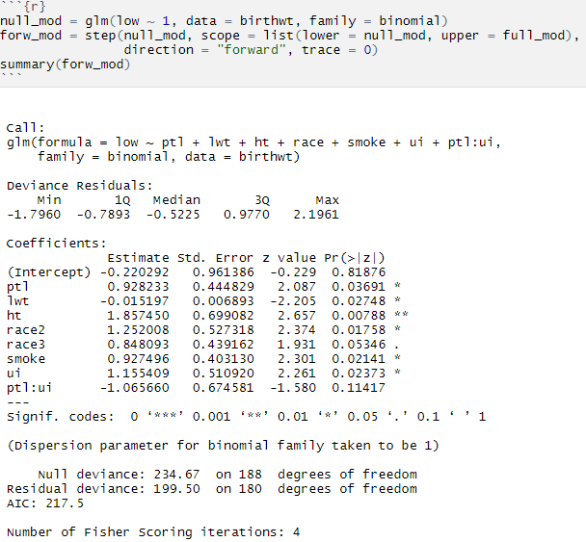
Backward Selection
Forward Selection

Slide 12
Results
The backward selected model has the lower AIC score (208.8), so we chose it as our best model.
From the backward selected model, the significant factors that are associated with low infant birthweight at a level of 0.05 include:
  mother‘s weight (lwt)
  number of previous premature labours (ptl)
  history of hypertension (ht)
  number of physician visits (ftv)
  interaction between mother's age and number of physician visits (age:ftv)
  interaction between number of previous premature labours and presence of uterine irritability (ptl:ui)

Slide 13
4. Question Two (Method & Result)
How well can these factors predict low birthweight?

Slide 14
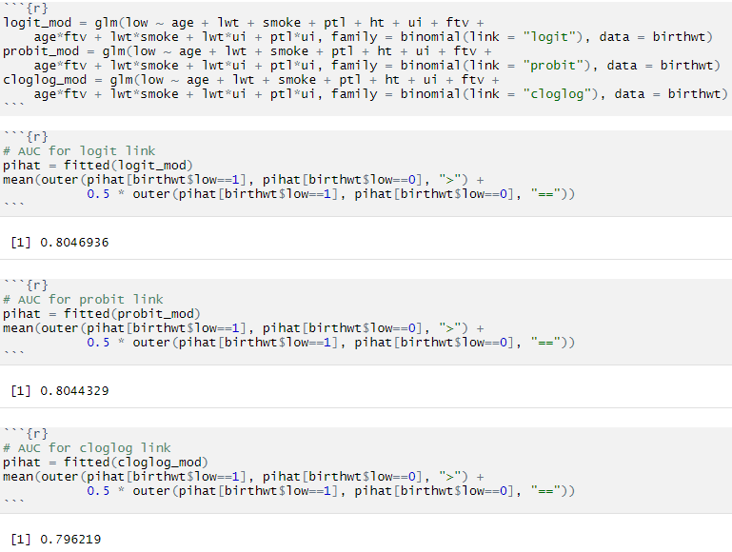
Choose the best link function
AUC for logit link: 0.8047
AUC for probit link: 0.8044
AUC for cloglog link: 0.7962
Therefore, the logit link has the largest area under the ROC curve, so we chose logit link.

Slide 15
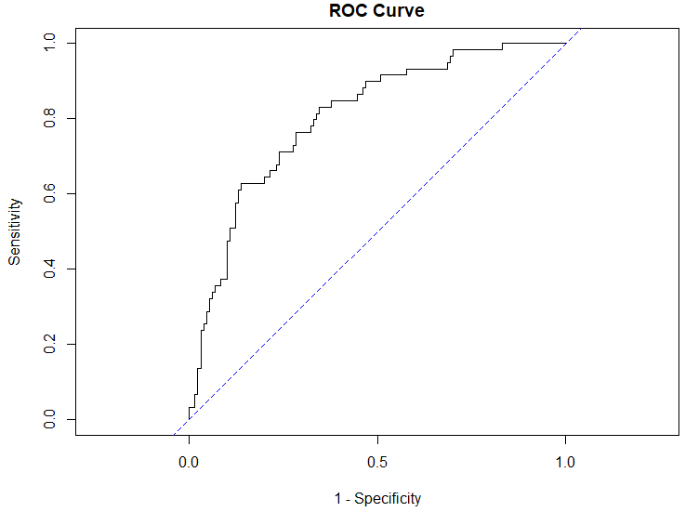
ROC curve for the best model
Backward selection
Logit link
AIC : 208.8

Slide 16
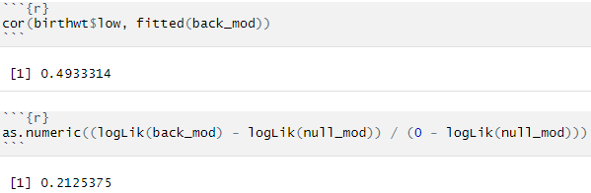

Predictive Power
The measure of predictive power (correlation between y and $π$hat) is 0.493
The measure of predictive power $\frac{L_{M}−L_{0}}{L_{S}−L_{0}}$ is 0.213

Slide 17
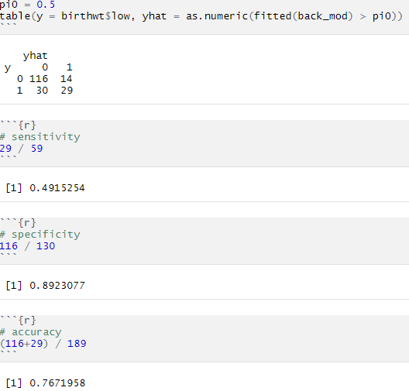
Max accuracy when cutoff = 0.5
Metrics | Cutoff = 0.5
Sensitivity | 49.2%
Specificity | 89.2%
Overall Accuracy | 76.7%

Slide 18
Why do we value sensitivity more than specificity?

Slide 19
Adjusting the cutoff to get higher sensitivity
Sensitivity | Cutoff | Specificity
80% | 0.27 | 67%
90% | 0.19 | 50%
95% | 0.13 | 32%
98% | 0.11 | 30%
100% | 0.05 | 17%

Slide 20
5. Summary
In our best model, `lwt`, `ptl`, `ht`, `ftv`, `age:ftv`, `ptl:ui` are significant factors that are associated with low infant birthweight at a level of 0.05
The factors of our best model to predict low birthweight are obtained from backward selection. The best link function is the logit link due to its highest area under the ROC curve. The AIC score of our best model is 208.8
The highest accuracy (77%) is achieved when we used a cutoff of 0.5, with a 50% sensitivity and 90% specificity.
The predictive power of our best model is not very high, but we can always achieve higher sensitivity by sacrificing the specificity.

Slide 21
6. References
https://www.marchofdimes.org/complications/low-birthweight.aspx
https://en.wikipedia.org/wiki/Low_birth_weight

Slide 22
Thanks for watching!
Have a nice summer break!

